Slide 1

Weekly Activities Database
Tuğberk Göktepe 18070006042
Ekin Uygar Duman 18070006048
Yiğit Gökkaya 18070006003

Slide 2
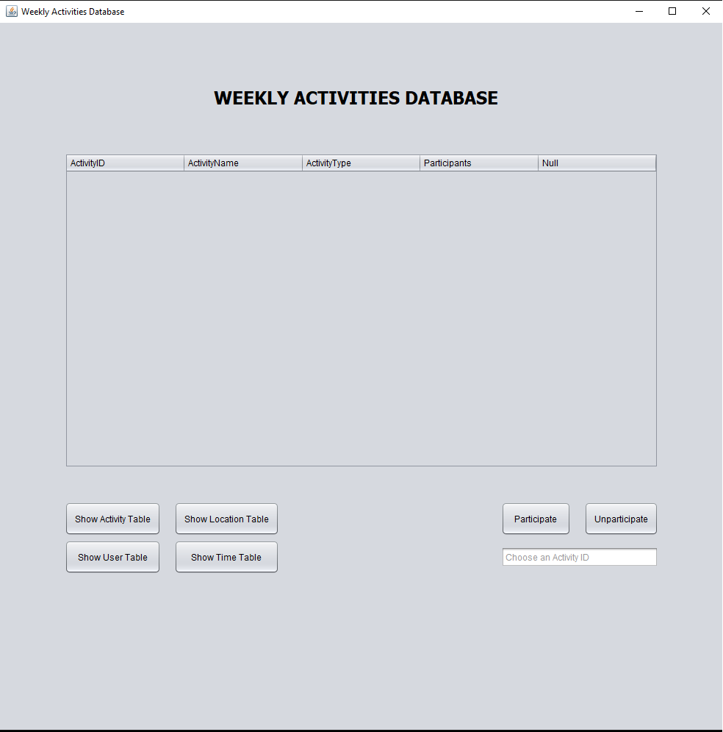
Here is our main screen.

Slide 3
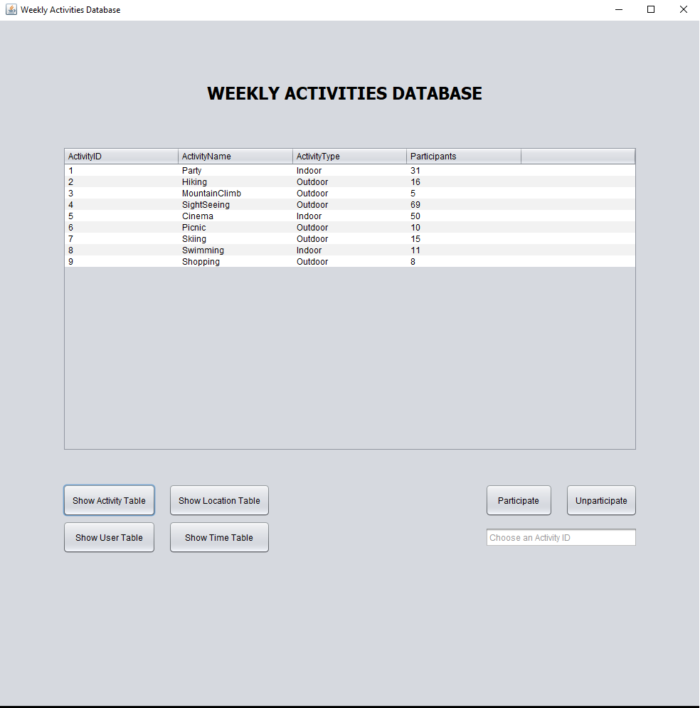
Here is the activity Table.

Slide 4
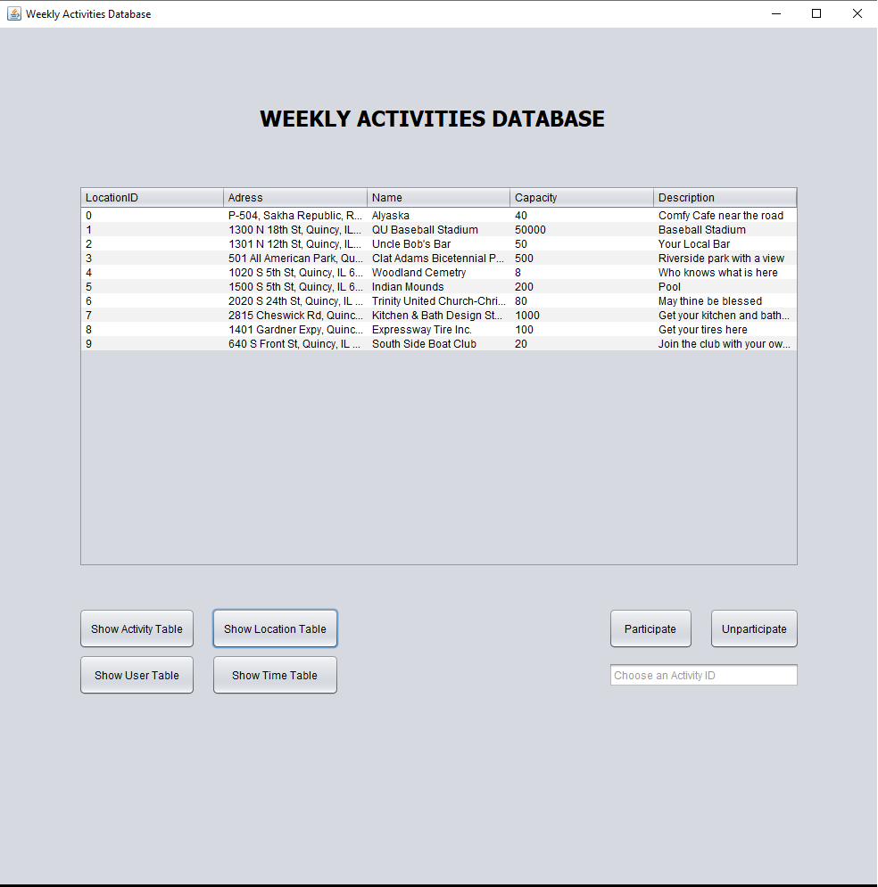
Here is the Location Table.

Slide 5
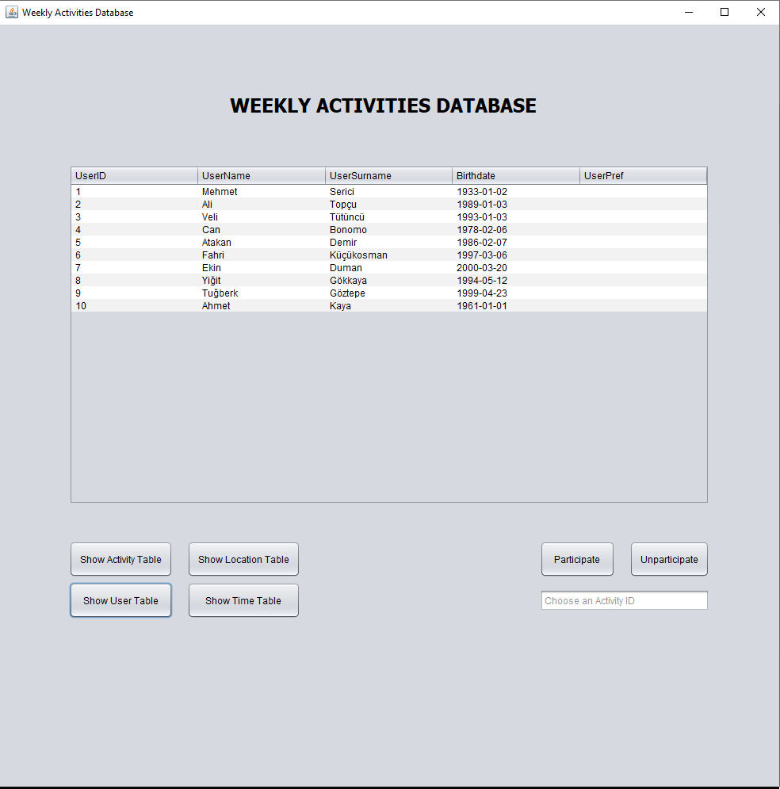
Here is the user Table.

Slide 6
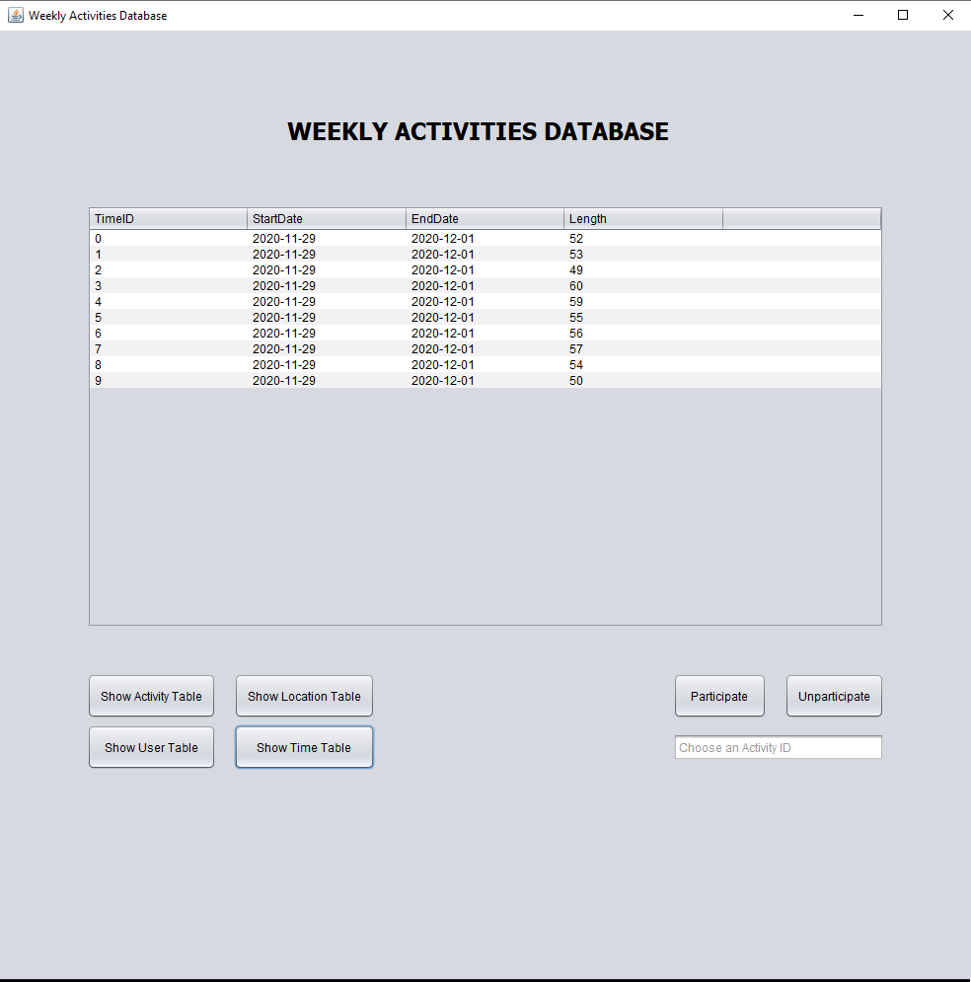
Here is the time Table.

Slide 7
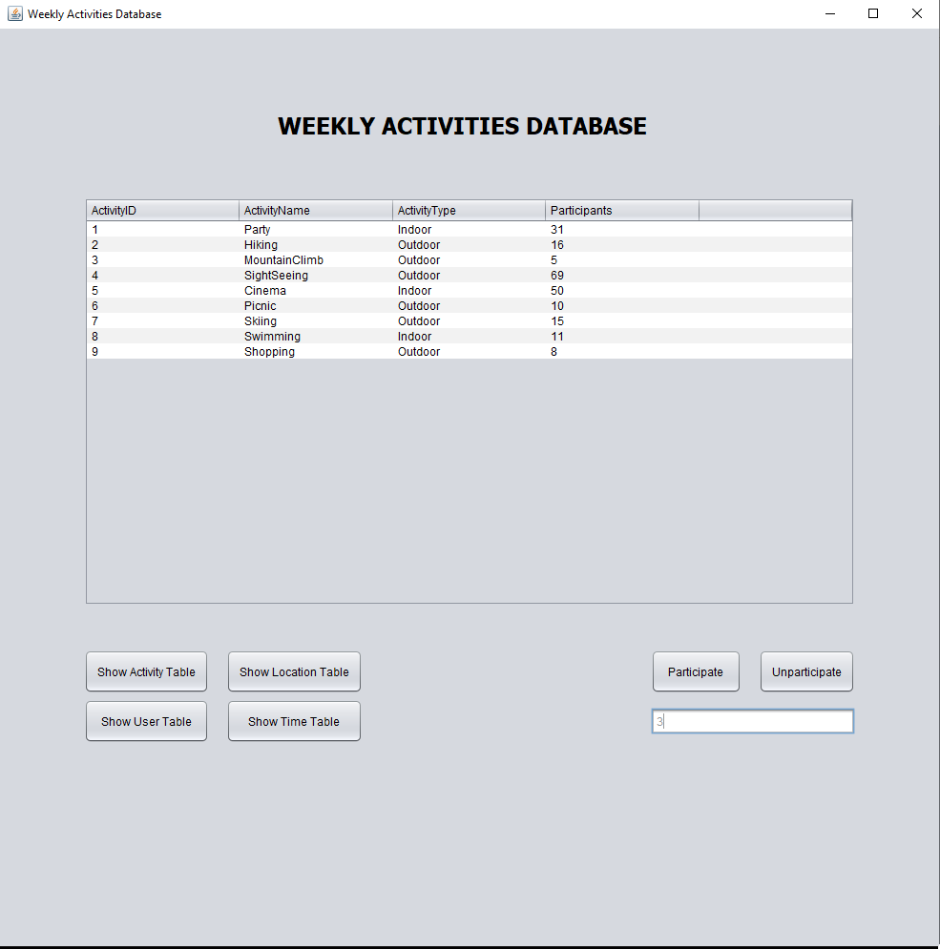
Here we are going to participate in an activity whose ID is 3.

Slide 8

As you can see, the participant count increased up by one. The new value is 6 now.

Slide 9
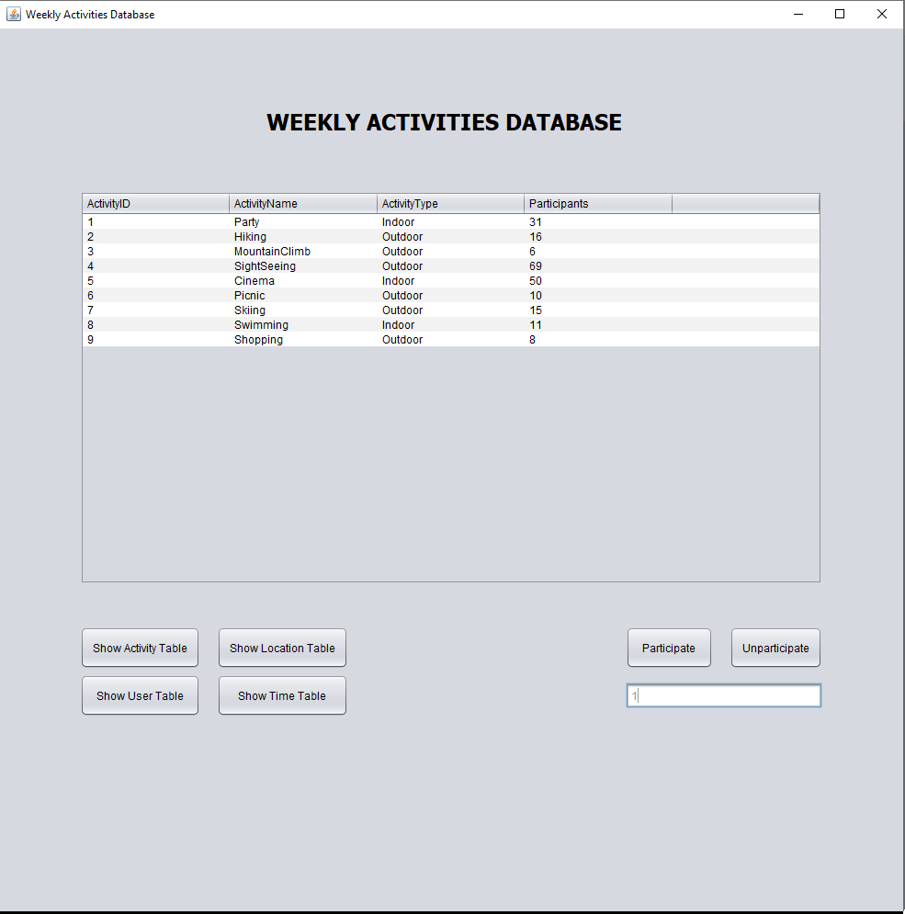
Here we are going to be unparticipating in an activity whose ID is 1.

Slide 10
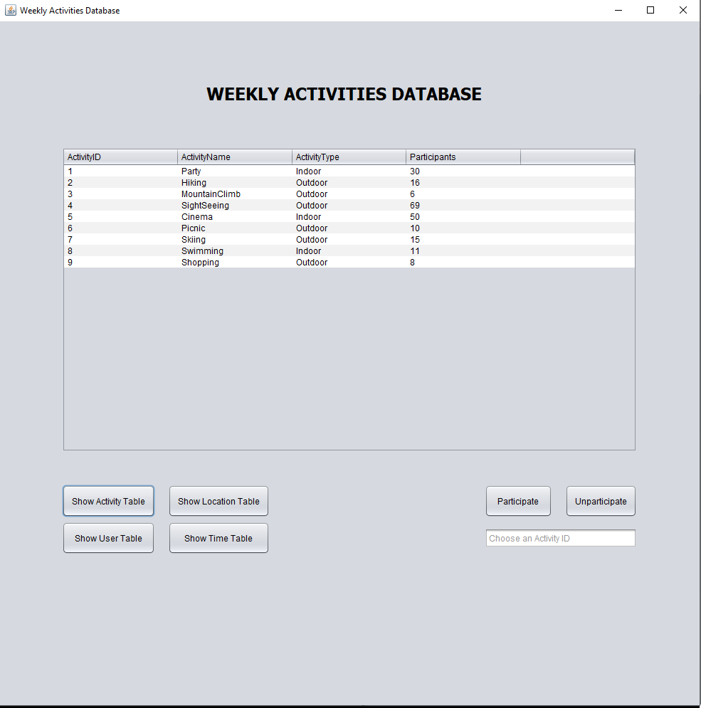
As you can see, the participant count decreased by one. The new value is 30 now.

Slide 11
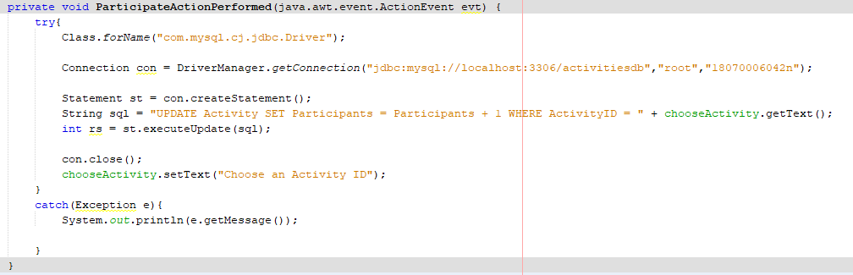
Here is how participate button works.

Slide 12
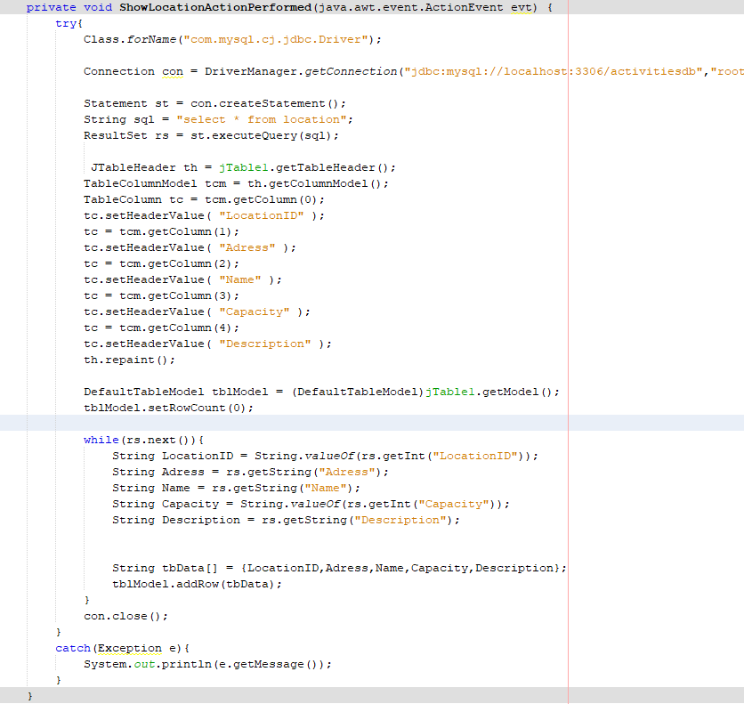
Here is how Show Location Table button works.

